Slide 1
A Lasting Foundation and Structure
Adrian Liew
21/10/2018

Slide 2
Key Scriptures
Isaiah 33:5-6
The Lord is exalted, for He dwells on high; He will fill Zion with His justice and righteousness.
He will be the sure foundation for your times, a rich store of salvation and wisdom and knowledge; the fear of the Lord is the key to this treasure.

Slide 3
Key Scriptures
Isaiah 28:16
So this is what the Sovereign Lord says: “See, I lay a stone in Zion, a tested stone, a precious cornerstone for a sure foundation; the one who relies on it will never be stricken with panic.

Slide 4
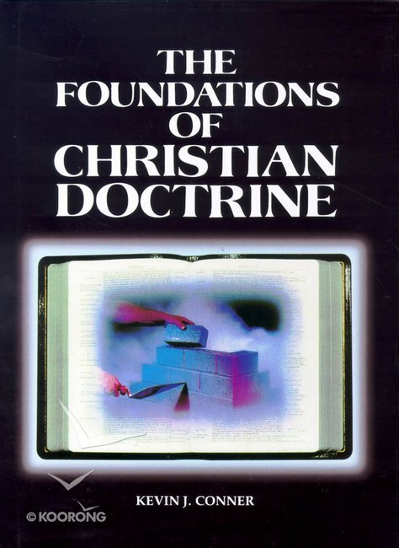
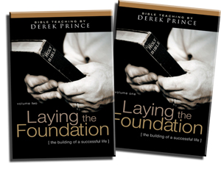
Foundational Studies
WHO we believe
WHAT we believe
WHY we believe

Slide 5

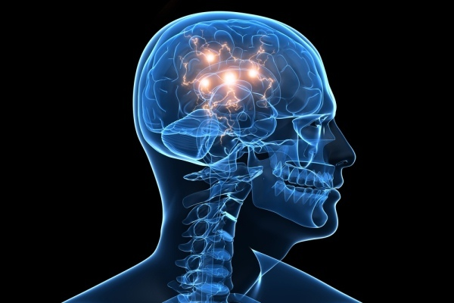
Foundational Studies
A person’s philosophy determines their beliefs
A person’s belief determines their attitudes
A person’s attitude determines their behaviour
A person’s behaviour determines their character
A person’s character determines their DESTINY
- Kevin J Conner

Slide 6
How Do We Know Our Foundation is Sure?
When shakings happen in our life

Slide 7
Hebrews 12:26-29
At that time his voice shook the earth, but now he has promised, “Once more I will shake not only the earth but also the heavens.” The words “once more” indicate the removing of what can be shaken—that is, created things—so that what cannot be shaken may remain.
Therefore, since we are receiving a kingdom that cannot be shaken, let us be thankful, and so worship God acceptably with reverence and awe, for our “God is a consuming fire.”

Slide 8


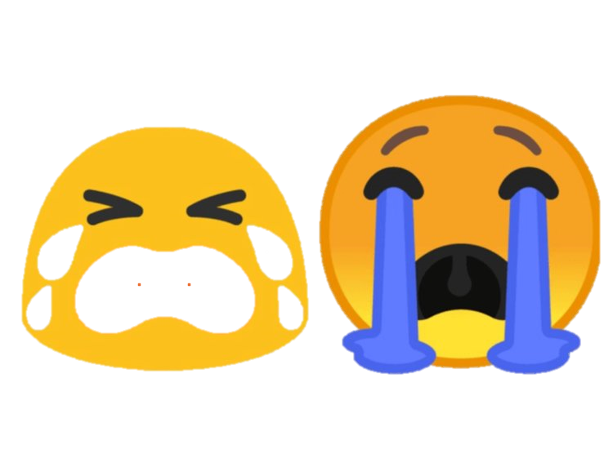
Cracks!

Slide 9
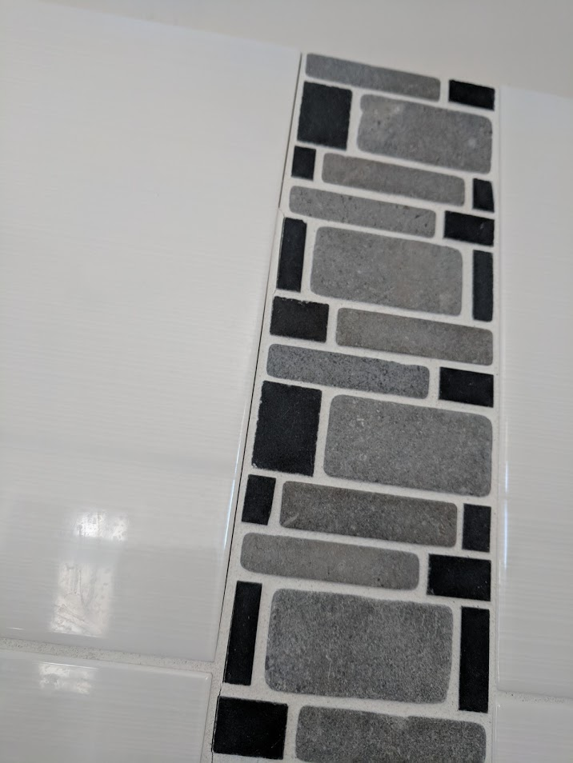

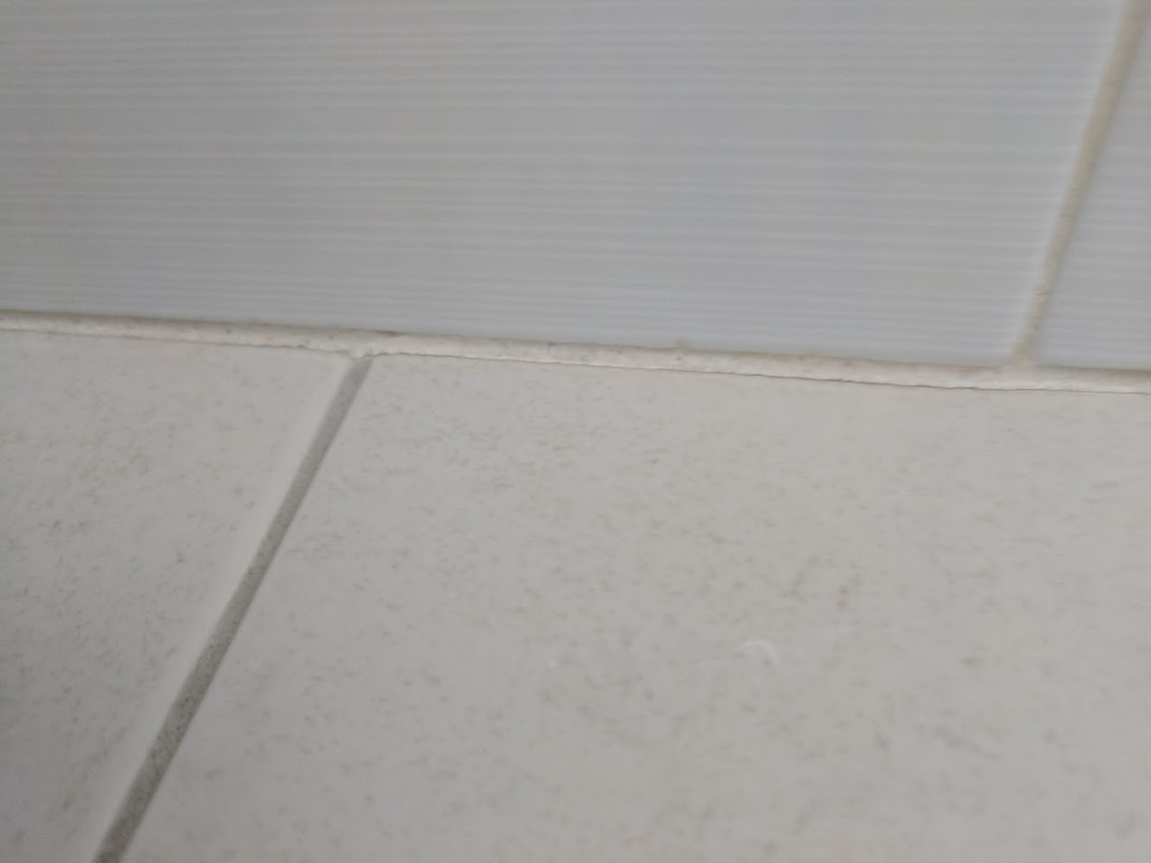
Cracks!

Slide 10


Cracks!

Slide 11
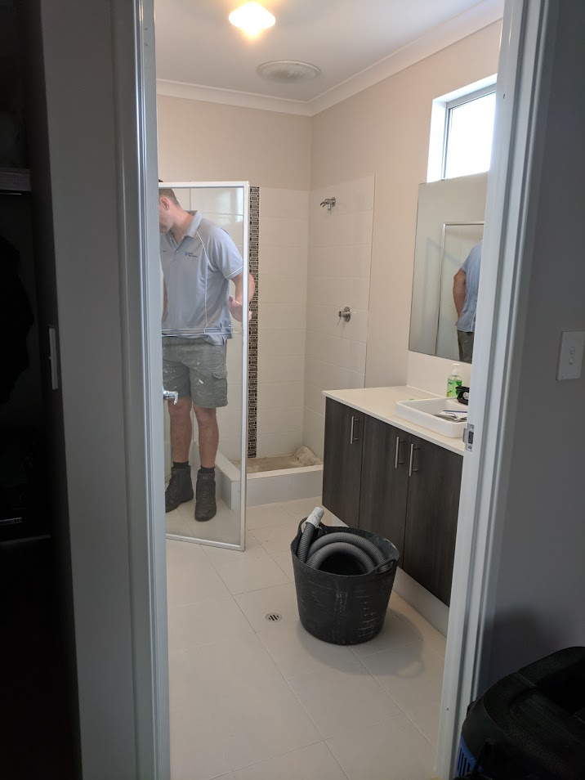
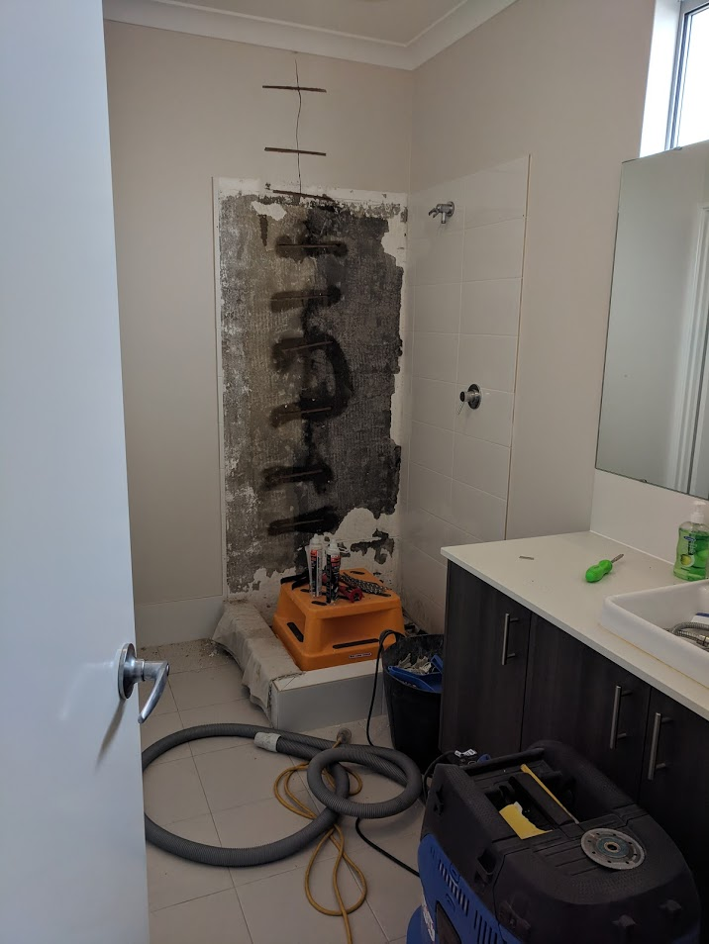
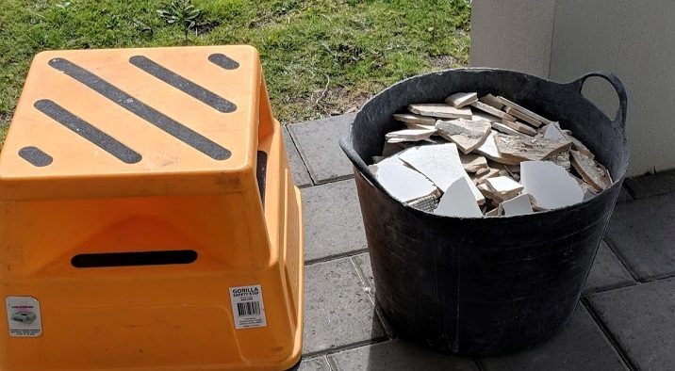
How The Builders Fix It

Slide 12
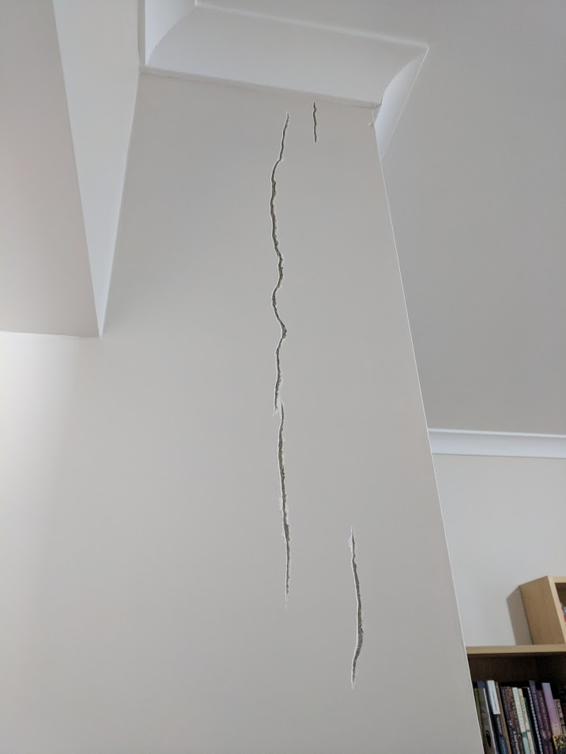
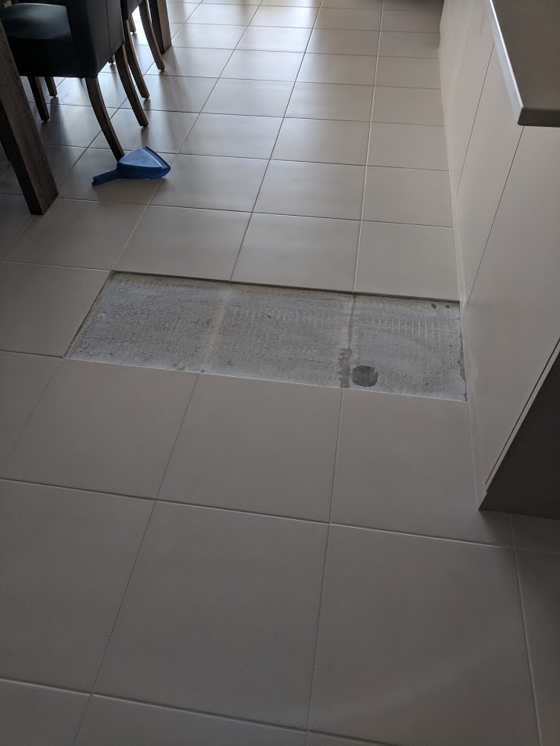
How The Builders Fix It

Slide 13
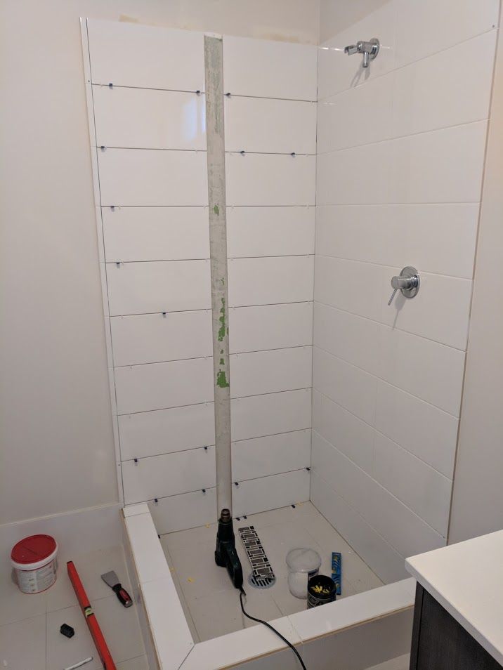
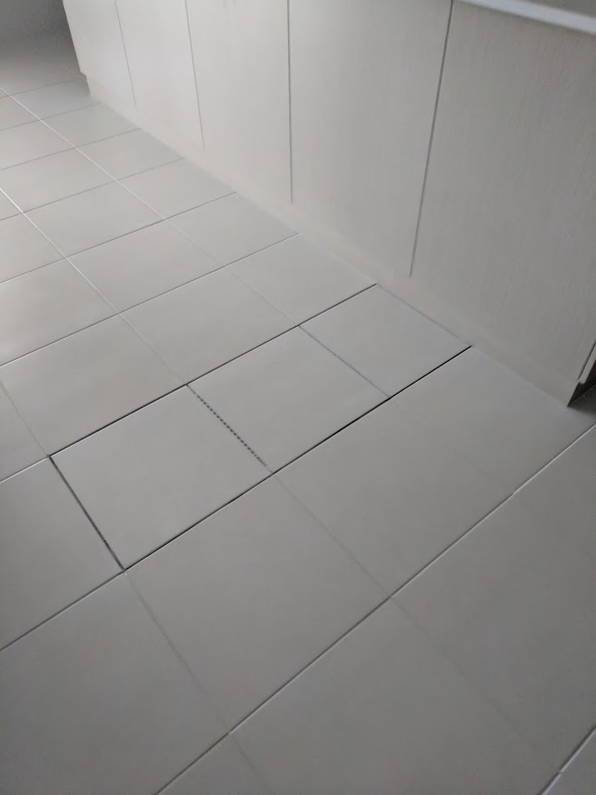
How The Builders Fix It

Slide 14
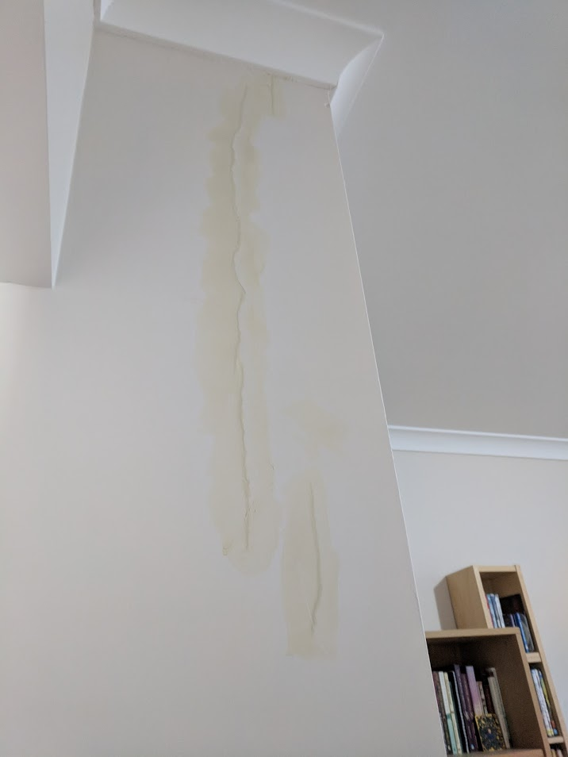
How The Builders Fix It

Slide 15
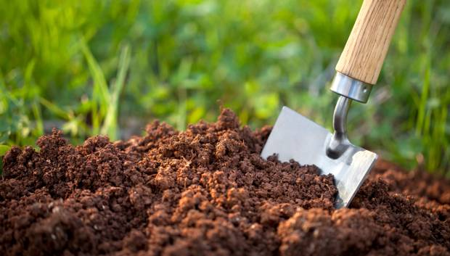
Spiritual Lessons
Fixing Things Our Own Way – Doesn’t Work
God will sometimes have to rip out everything to get down to the root issue
Recognize the Issue and be Quick to Repent
Our Breakthrough Will Come as Quick as We Repent
What’s the Soil Condition of Our Heart?
The condition of the soil can affect our foundation.

Slide 16
Having a Lasting Foundation and Structure
Walk before the work
Character before competence
Substance before strategy
Obedience before operation
Integrity before initiative
Worship before witness

